Slide 1

Data preprocessing
NIE Junrong(25428225)

Slide 2

Data preprocessing
▍Unified processing of multiple files: Automatically batch-read all CSV files, extract the industry/month from the file names, and merge them into a complete dataset.
▍Handling of missing values: Missing salary indicators are marked as "Unknown" for categorical fields.
▍ Uniform field format: Convert dates to YYYY-MM-DD format, standardize job titles, and unify industry labels
▍ Salary field cleaning (range is directly calculated as the mean)Support formats: $20,000–$30,000, 45k-50k, 35000, Up to 23K
Rule: 45k-50k → Directly calculated as 47,500

Slide 3
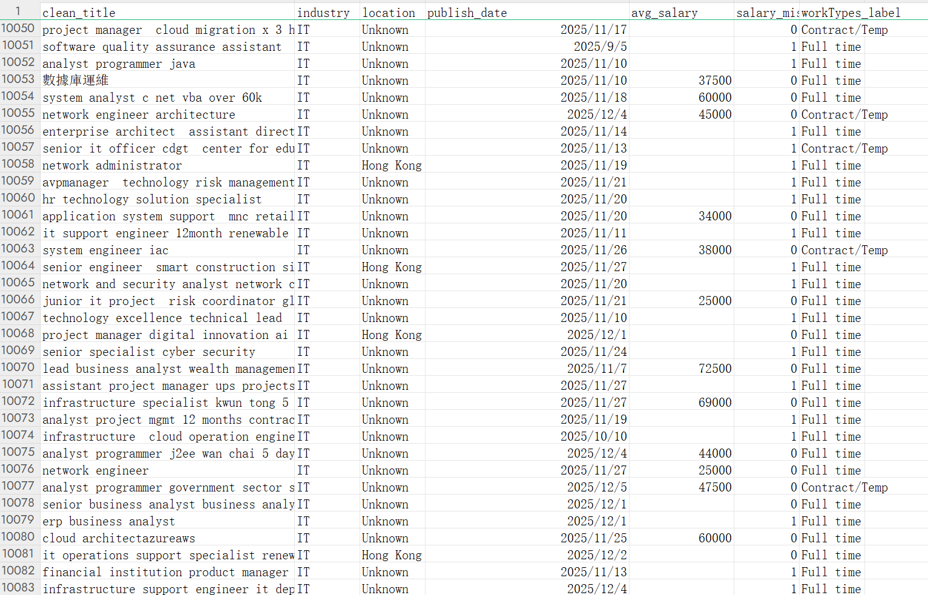
Data preprocessing
▍After Data preprocessing
Number of documents
8 → 1
Total data volume
29,092
Effective salary
4,316

